Slide 1
EDA LENDING CLUB

Slide 2
Business Objective
the objective of this EDA study is to understand the driving factors (or driver variables)behind loan default, i.e. the variables which are strong indicators of default.

Slide 3
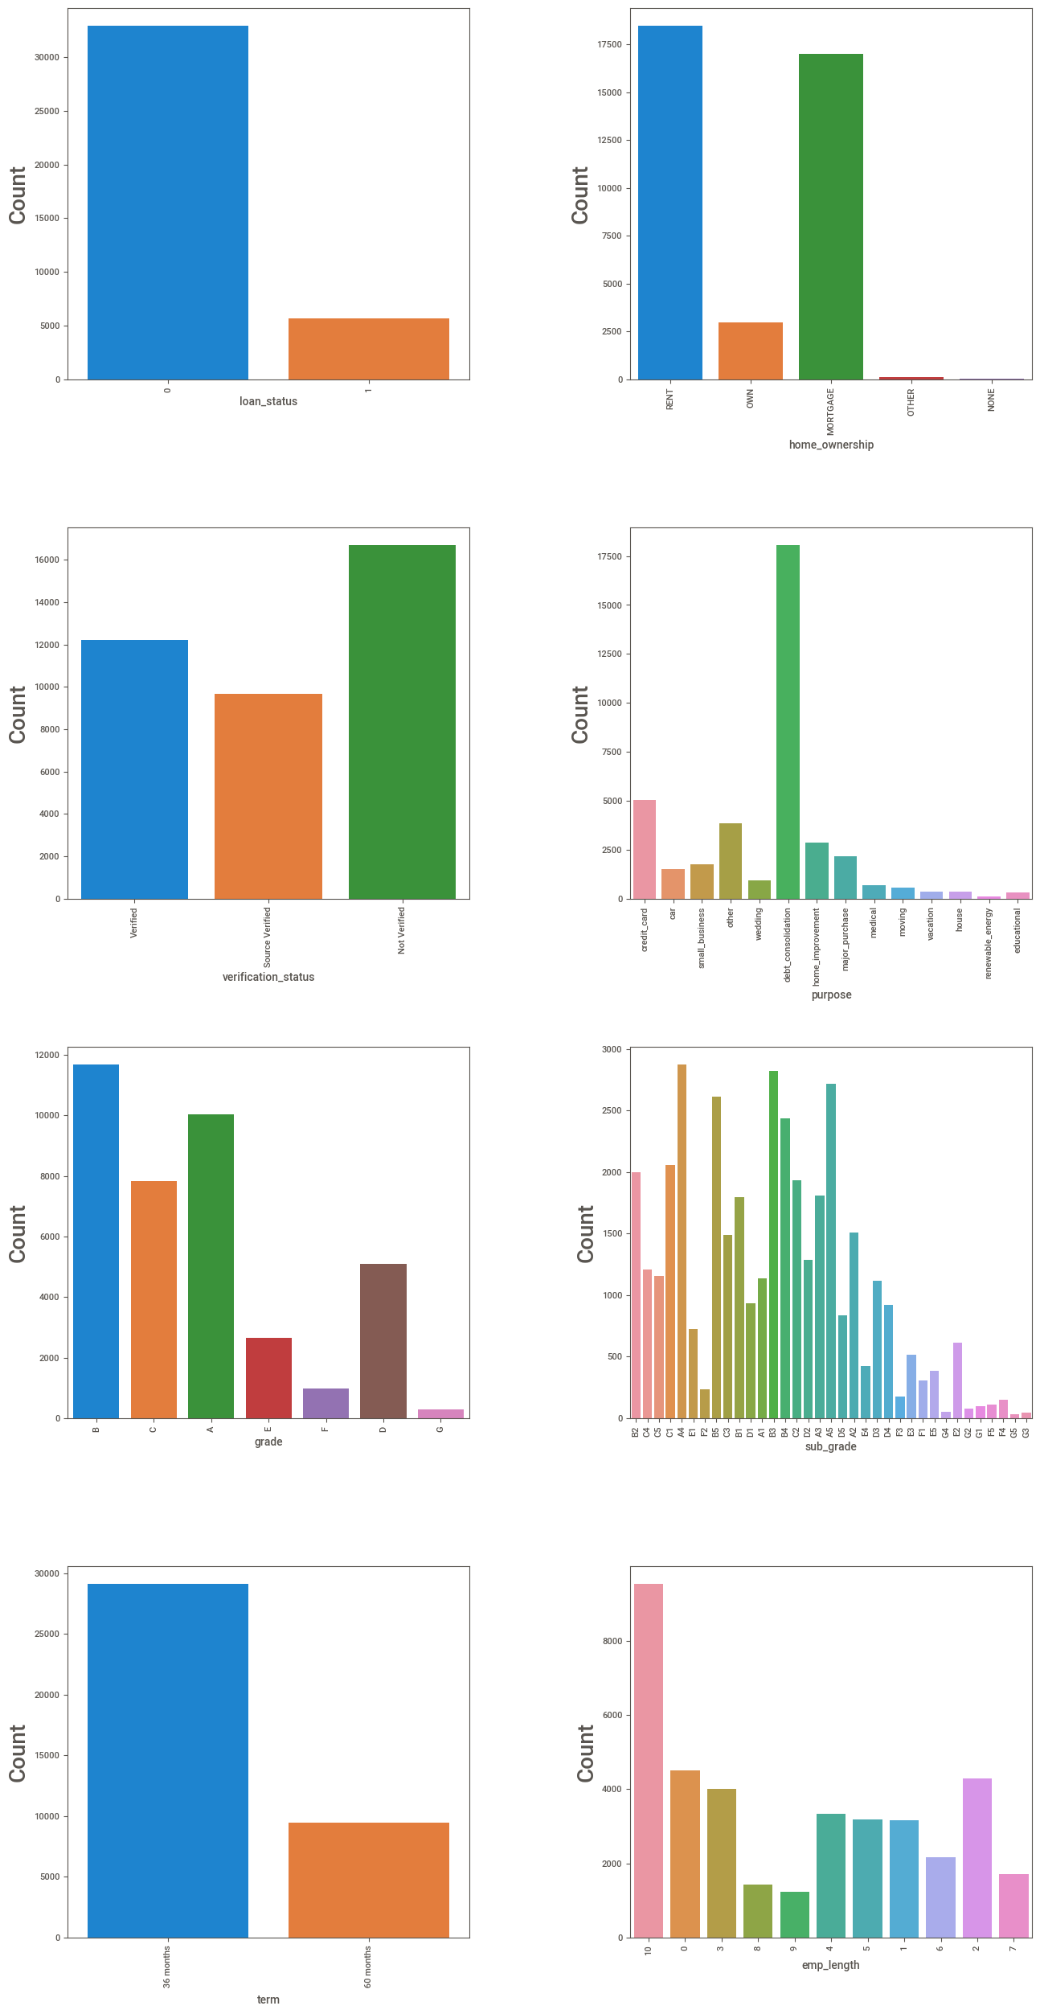
Distribution of listed variables w.r.t their count

Slide 4
Plot Summary
Loan status plot clearly highlights 6.5 to 1 of Fully paid to defaulters' ratio.
Company has been making one loss to every 6.5 non defaulting account
home ownership plot shows that majority of the borrowers are Rented/mortgage
Verification status plot shows that company has been accepting non verified
customers compared to verified and source verified.
Purpose plot shows that majority of the loans are borrowed for debt consolidation.
Grade A and B loan are distributed proportionately more than other grades.
Sub grades' A4, A5,B3,B5,C2 are distributed proportionately higher than other sub grades.
Demand of 36 months loan has been almost 3 times the demand of 60 months loan.
Company has been funding more loan to 10+ years of employment length than other years. Company has relatively lesser customer with employment length of 8

Slide 5
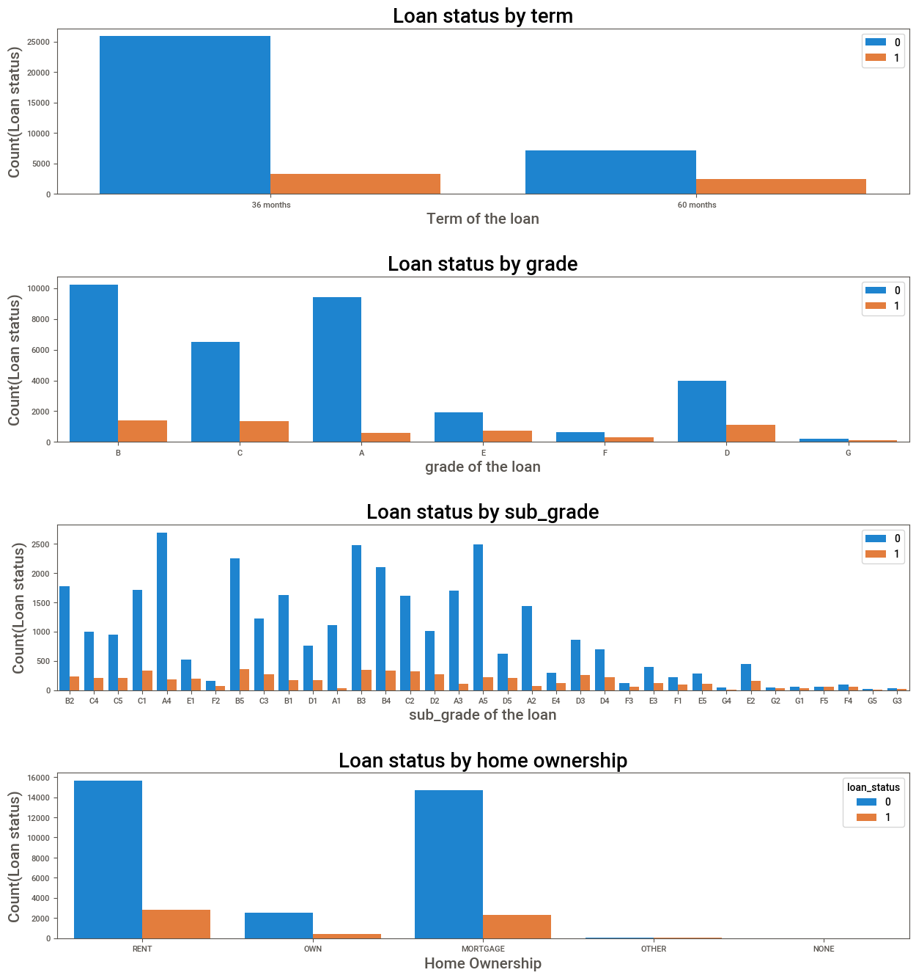

Slide 6
Plot Finding
Proportion of fully paid to defaulters are much better in 36 month term than 60 months.
Proportion of fully paid to defaulters are much better in grade A,B and C than grade E,F,G.
Grade G is the worst performer.
Subgrades’ A4,A5,b3,B4,B5 are best performers whereas G5,G3,F5 are worst performers.
Default risk across the home ownership level is low.

Slide 7
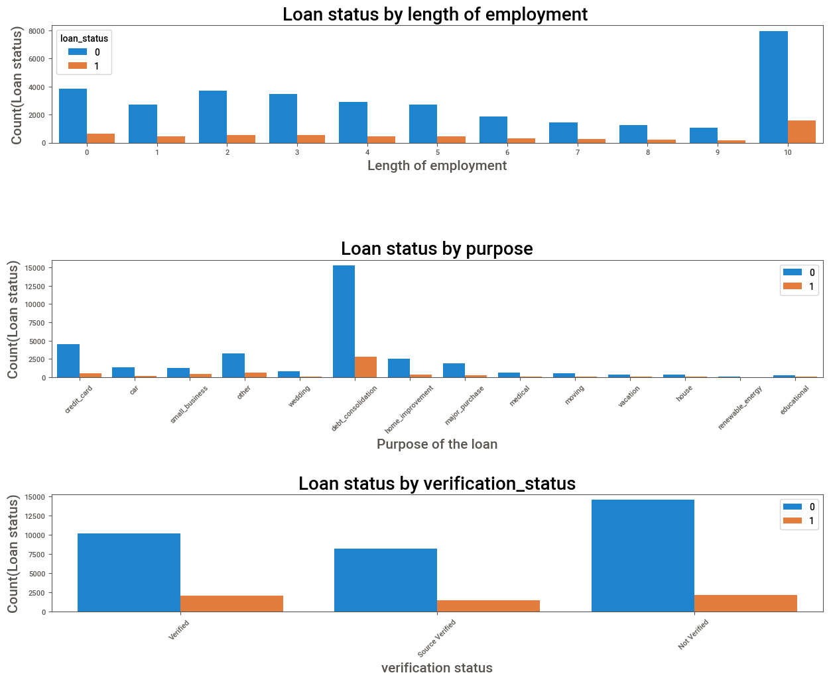

Slide 8
Plot finding
Proportion of fully paid to defaulters are considerably similar at all level of employment length.
Proportion of fully paid to defaulters are much better in verification status of non verified better than verified and source verified.
Default risk is considerably negligible where the purpose have been Moving, Vacation, and educational.

Slide 9
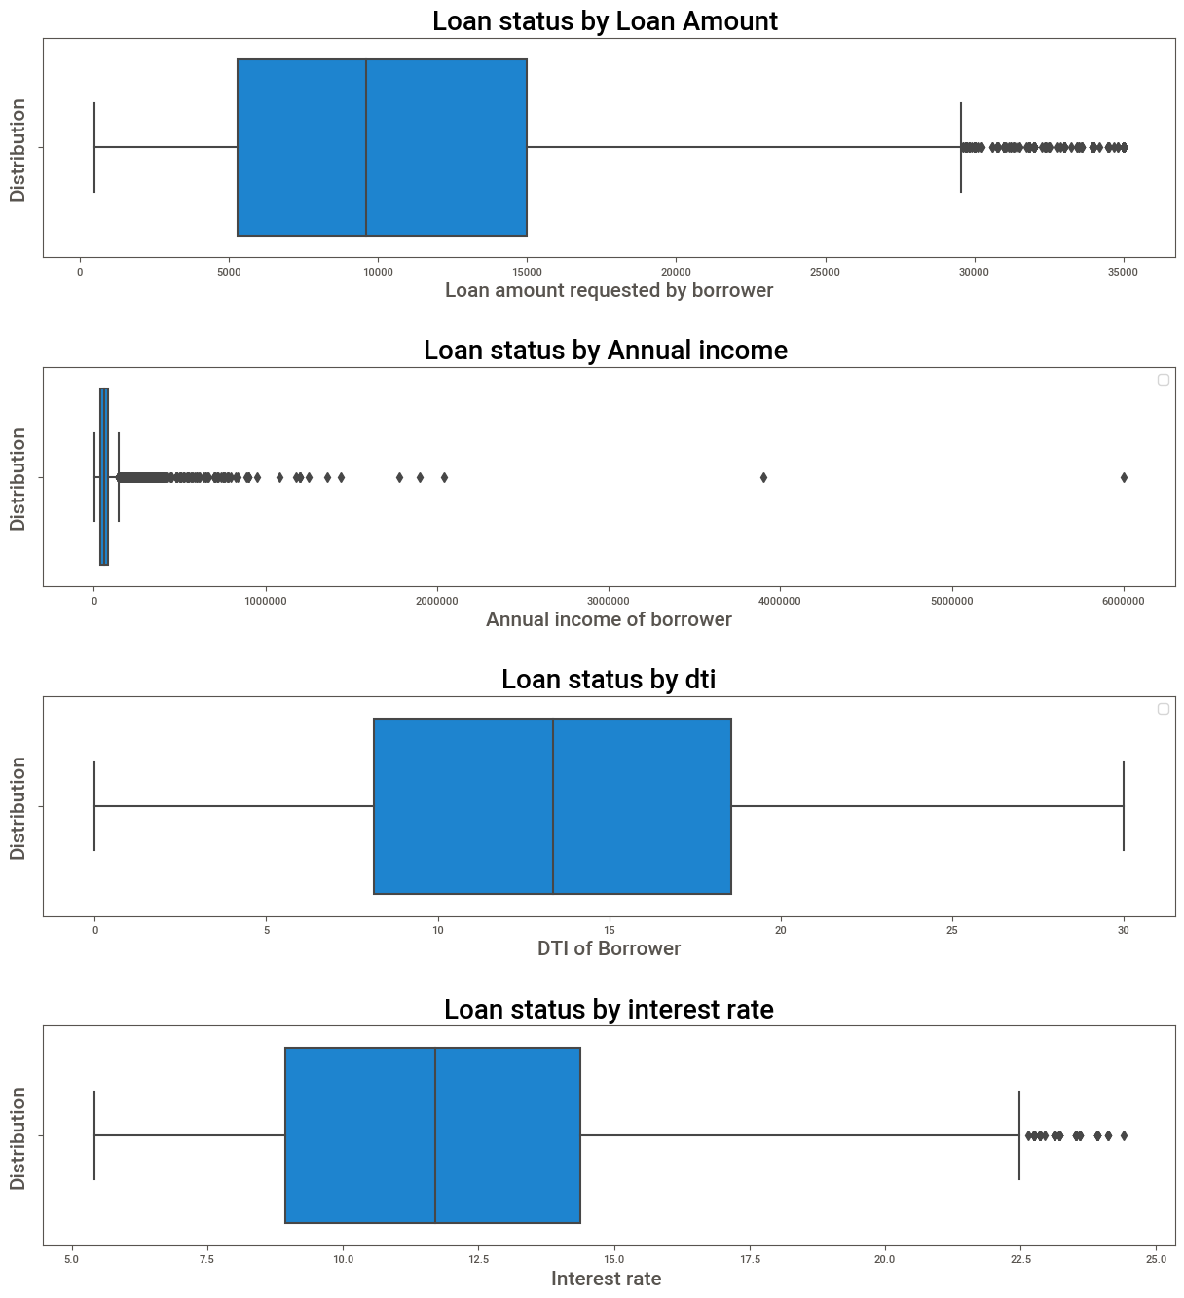
Loan Status By Continuous variables

Slide 10
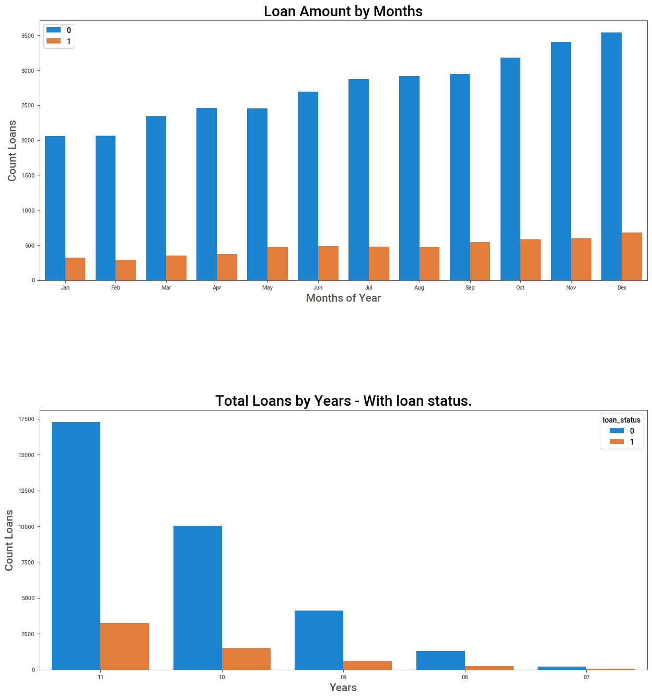
Finding
defaulter and fully paid customers have grown from 2007 to 2011.
defaulter and fully paid customers have grown from january to december.

Slide 11
loan_status | 0 | 1
emp_title
AT&T | 79.000000 | 21.000000
Bank of America | 81.000000 | 19.000000
Department of Defense | 89.000000 | 11.000000
IBM | 86.000000 | 14.000000
Kaiser Permanente | 86.000000 | 14.000000
Lockheed Martin | 95.000000 | 5.000000
Self Employed | 88.000000 | 12.000000
State of California | 89.000000 | 11.000000
U.S. Army | 80.000000 | 20.000000
UPS | 77.000000 | 23.000000
US ARMY | 87.000000 | 13.000000
US Air Force | 88.000000 | 12.000000
US Army | 86.000000 | 14.000000
USAF | 96.000000 | 4.000000
USPS | 82.000000 | 18.000000
United States Air Force | 88.000000 | 12.000000
Verizon Wireless | 90.000000 | 10.000000
Walgreens | 92.000000 | 8.000000
Walmart | 69.000000 | 31.000000
Wells Fargo | 92.000000 | 8.000000
Employee title such as Lockheed martin, USAF ,Wells Fargo, Walgreenshave perform better
Walmart is the worst performer.

Slide 12
loan_status | 0 | 1
addr_state
AK | 0.160000 | 0.040000
AL | 0.990000 | 0.140000
AR | 0.540000 | 0.070000
AZ | 1.880000 | 0.320000
CA | 15.100000 | 2.920000
CO | 1.730000 | 0.250000
CT | 1.640000 | 0.240000
DC | 0.510000 | 0.040000
DE | 0.260000 | 0.030000
FL | 5.900000 | 1.310000
GA | 2.970000 | 0.560000
HI | 0.360000 | 0.070000
IA | 0.010000 | 0.000000
ID | 0.010000 | 0.000000
IL | 3.320000 | 0.510000
IN | 0.020000 | 0.000000
KS | 0.580000 | 0.080000
KY | 0.690000 | 0.120000
LA | 0.970000 | 0.140000
MA | 2.950000 | 0.410000
MD | 2.230000 | 0.420000
ME | 0.010000 | 0.000000
MI | 1.560000 | 0.270000
MN | 1.360000 | 0.210000
MO | 1.440000 | 0.300000
MS | 0.040000 | 0.010000
MT | 0.190000 | 0.030000
NC | 1.650000 | 0.300000
NE | 0.010000 | 0.010000
NH | 0.370000 | 0.060000
NJ | 3.920000 | 0.720000
NM | 0.400000 | 0.080000
NV | 0.960000 | 0.280000
NY | 8.300000 | 1.280000
OH | 2.650000 | 0.400000
OK | 0.640000 | 0.100000
OR | 0.940000 | 0.180000
PA | 3.340000 | 0.470000
RI | 0.440000 | 0.060000
SC | 1.020000 | 0.170000
SD | 0.130000 | 0.030000
TN | 0.040000 | 0.010000
TX | 6.070000 | 0.820000
UT | 0.550000 | 0.100000
VA | 3.090000 | 0.460000
VT | 0.120000 | 0.020000
WA | 1.790000 | 0.330000
WI | 0.980000 | 0.160000
WV | 0.390000 | 0.050000
WY | 0.200000 | 0.010000
State such as California, new York , Texas and Florida have state where company are experiencing high number of fully paid as well as defaulters.

Slide 13
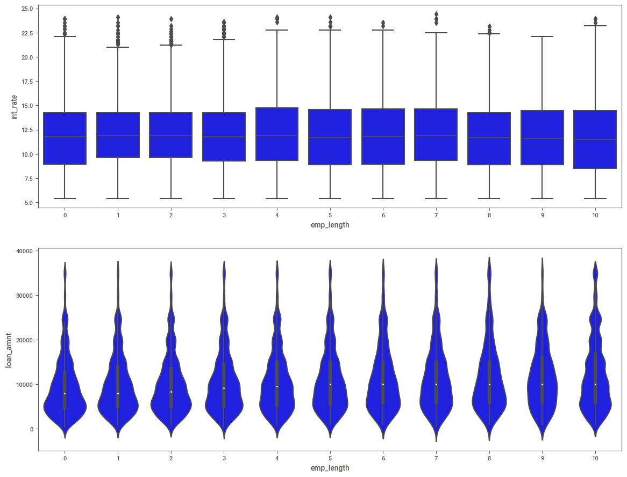
There is not much difference in interest rate among different level of work experience.
loan amount has been higher for employment length of 10 years.

Slide 14
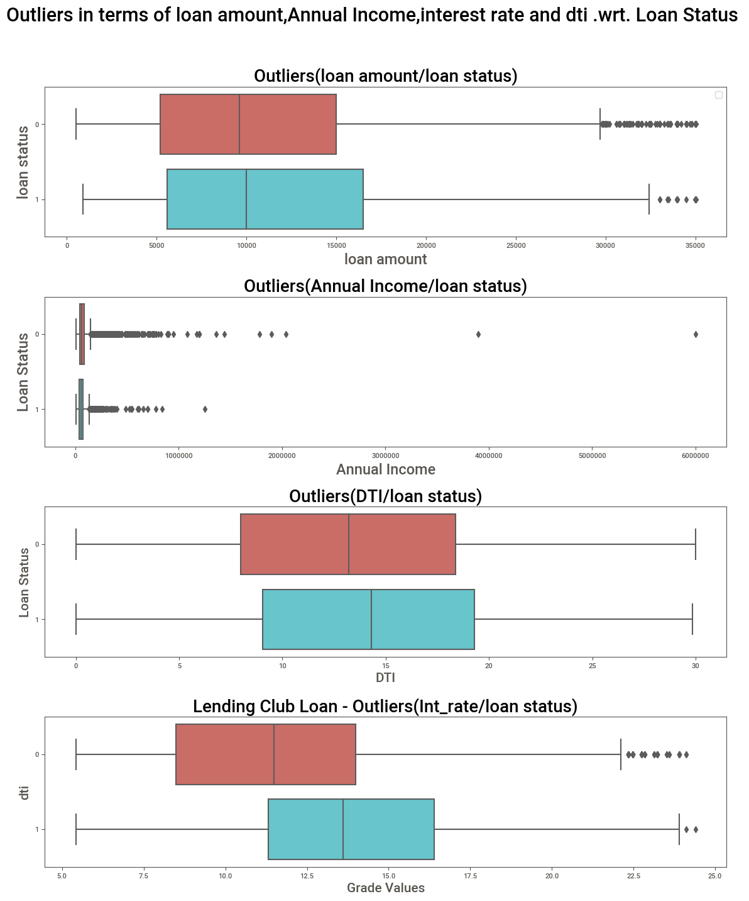
no outliers in DTI
High outliers in Annual income and loan amount.

Slide 15
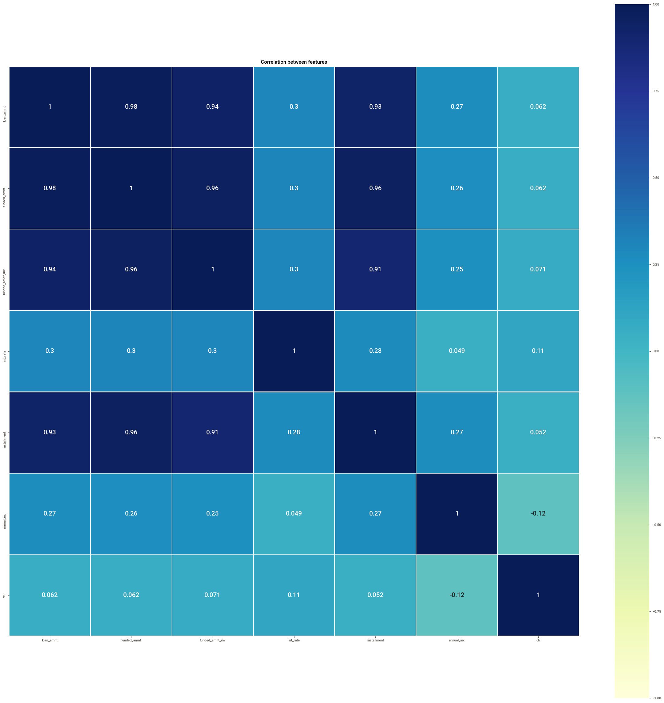
Strong Correlation between loan amount, amount funded by investor, amount funded by LC and installment.
They form a segment with very high correlation.

Slide 16
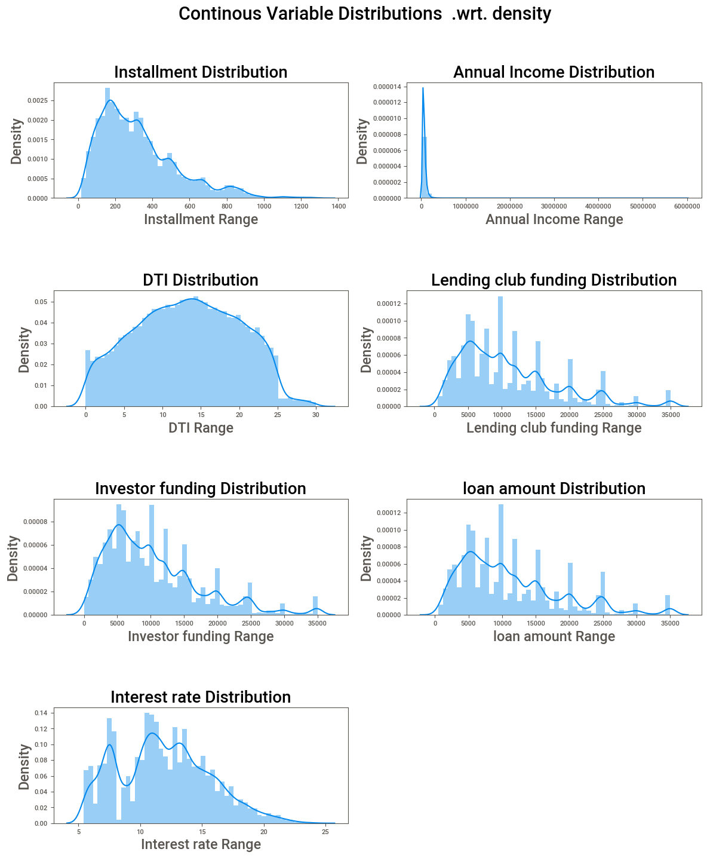
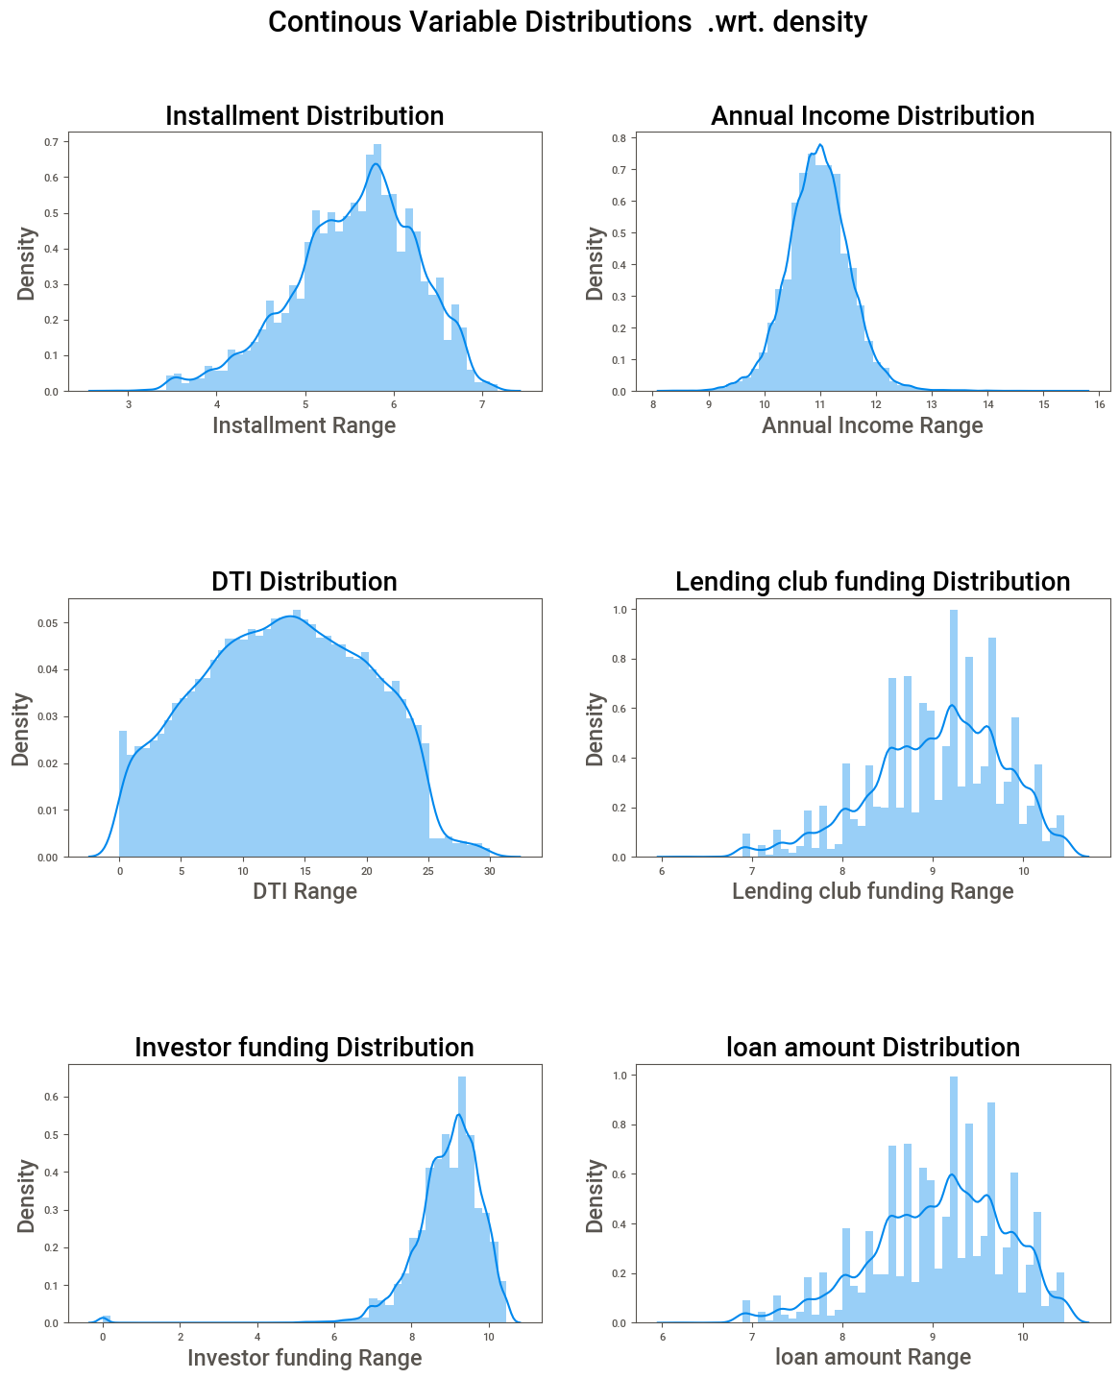

Slide 17
Plot findings
DTI has normal distribution
Installment, Annual income, amount funded by LC,Loan amount, amount funded by investor and interest rate are positively skewed.
Skewed variables have now normal distribution after log1 transformation as we managed the outliers efficiantly without dropping them.

Slide 18
Findings
Loan status plot clearly highlights 6.5 to 1 of Fully paid to defaulters' ratio.
Company has been making one loss to every 6.5 non defaulting account
home ownership plot shows that majority of the borrowers are Rented/mortgage
Verification status plot shows that company has been accepting non verified
customers compared to verified and source verified.
Purpose plot shows that majority of the loans are borrowed for debt consolidation.
Grade A and B loan are distributed proportionately more than other grades.
Sub grades' A4, A5,B3,B5,C2 are distributed proportionately higher than other sub grades.
Demand of 36 months loan has been almost 3 times the demand of 60 months loan.
Company has been funding more loan to 10+ years of employment length than other years. Company has relatively lesser customer with employment length of 8

Slide 19
Findings
Proportion of fully paid to defaulters are much better in 36 months term than 60 months.
Proportion of fully paid to defaulters are much better in grade A,B and C than grade E,F,G.
Grade G is the worst performer.
Subgrades’ A4,A5,b3,B4,B5 are best performers whereas G5,G3,F5 are worst performers.
Default risk across the home ownership level is low.

Slide 20
Findings
Proportion of fully paid to defaulters are considerably similar at all level of employment length.
Proportion of fully paid to defaulters are much better in verification status of non verified better than verified and source verified.
Default risk is considerably negligible where the purpose have been Moving, Vacation, and educational.
defaulter and fully paid customers have grown from 2007 to 2011.
defaulter and fully paid customers have grown from january to december.

Slide 21
Findings
defaulter and fully paid customers have grown from 2007 to 2011.
defaulter and fully paid customers have grown from January to December.
State such as California, new York , Texas and Florida have state where company are experiencing high number of fully paid as well as defaulters.
There is not much difference in interest rate among different level of work experience.
loan amount has been higher for employment length of 10 years.

Slide 22
Findings
no outliers in DTI
High outliers in Annual income and loan amount.
DTI has normal distribution
Installment, Annual income, amount funded by lending club, Loan amount, amount funded by investor and interest rate are positively skewed.
Skewed variables have now normal distribution after log1 transformation as we managed the outliers efficiently without dropping them.

Slide 23
Findings
Strong Correlation between loan amount, amount funded by investor, amount funded by LC and installment.
They form a segment with very high correlation.
Interest rate, grade and sub grade shows strong association among each other, and they form a segment with strong association.

Slide 24
Recommnedation

Slide 25
Thank you

